Slide 1
Peas & caracterización de ambiente
Martin Noboa - A01704052

Slide 2
INDICE
Introduction
PEAS
Environment

Slide 3
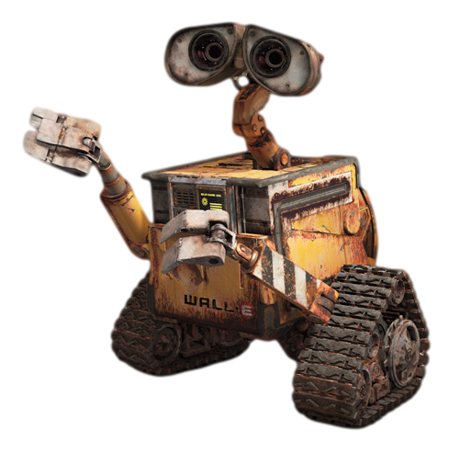
INTRODUCTION
Why Wall-E? While the main character of the movie is not an agent because it is portrayed as a feeling and reasoning character, that is not the same as its “factory setting”. In the end, it is an agent with the objective of making constructions out of trash.

Slide 4
peas

Slide 5
QUARTERLY PERFORMANCE
Type | Performance Measure | Environment | Actuators | Sensors
Wall-E | Efficient Fast Secure Independent | Wasteland Cities Ruins Garbage deposits | Wheels Optics Arms Compressors Horn | Optic Temperature sensors Wind speed sensor

Slide 6
Environment

Slide 7
Environment
Environment | Partial? | Stochastic? | Episodic? | Dynamic? | Continuous? | Single?
Wall-E | Partially observable | Stochastic | Sequential | Dynamic | Continuous | Single

Slide 8
THANK YOU

